Slide 1
Discussion 8
Joins
Bin Wang

Slide 2
Agenda
Joins
SNLJ
PNLJ
BNLJ
INLJ
Sort-Merge Join

Slide 3
Joins

Slide 4
Joins
Bit of notation:
[R] = number of pages in R
p_{R} = number of records per page in R
|R| = number of records in R (the cardinality of R)
|R| = p_{R} * [R]
We typically exclude the final write’s I/O cost
Don’t add the cost of writing the joined output to disk
We might decide to stream it to the next operator instead of materializing results!

Slide 5
Simple Nested Loop Join (SNLJ)
Direct translation of the definition of join into code
To perform the join R ⋈_{𝜃} S, just take each row in R, and scan through S to find the matching rows!
for each row r in R:
for each row s in S:
if 𝜃(r, s): output r joined with s

Slide 6
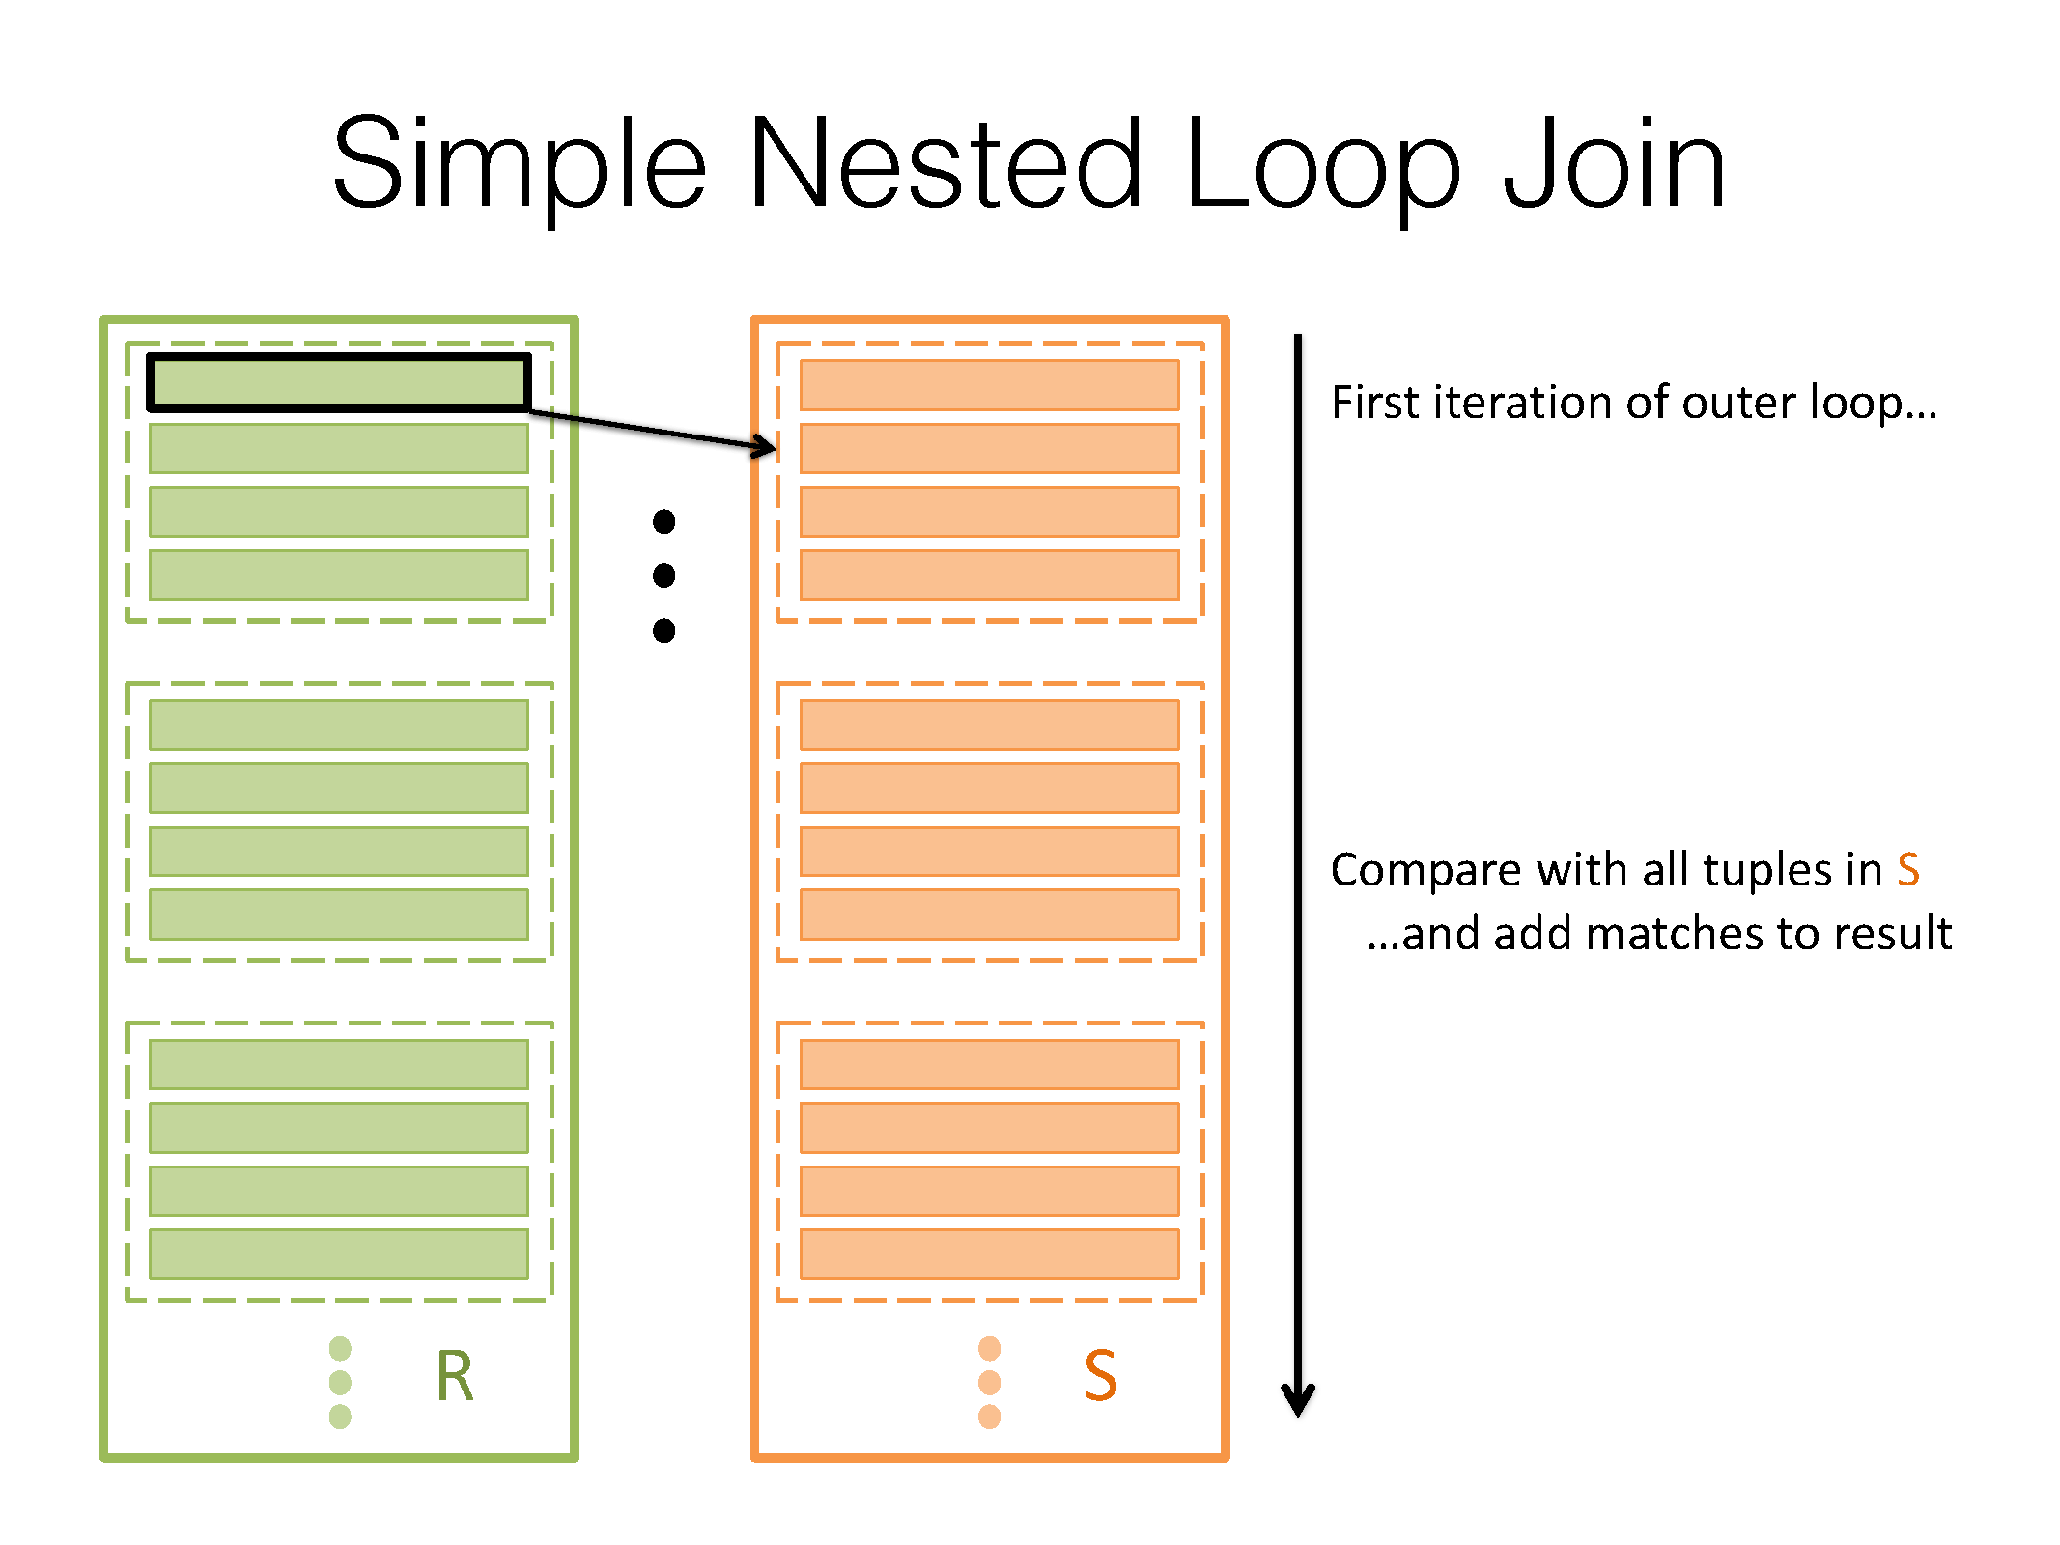
Notes:
Thanks Pete for the images

Slide 7
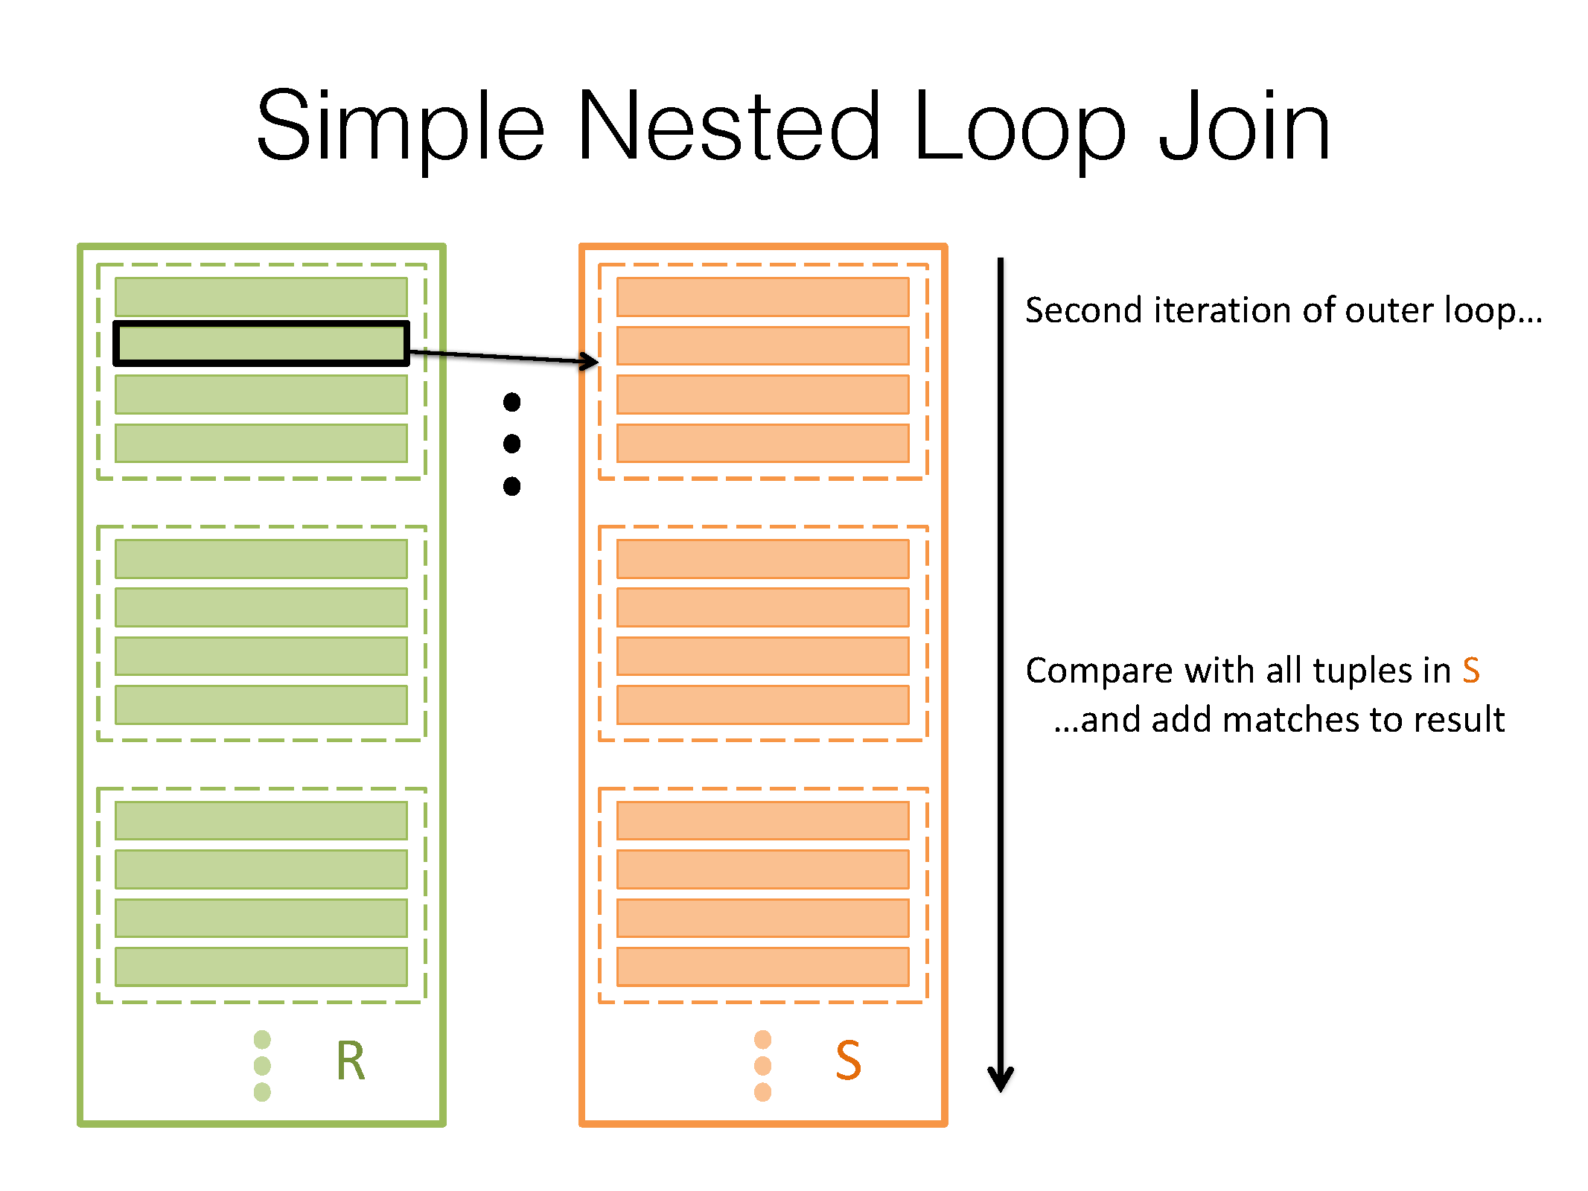

Slide 8
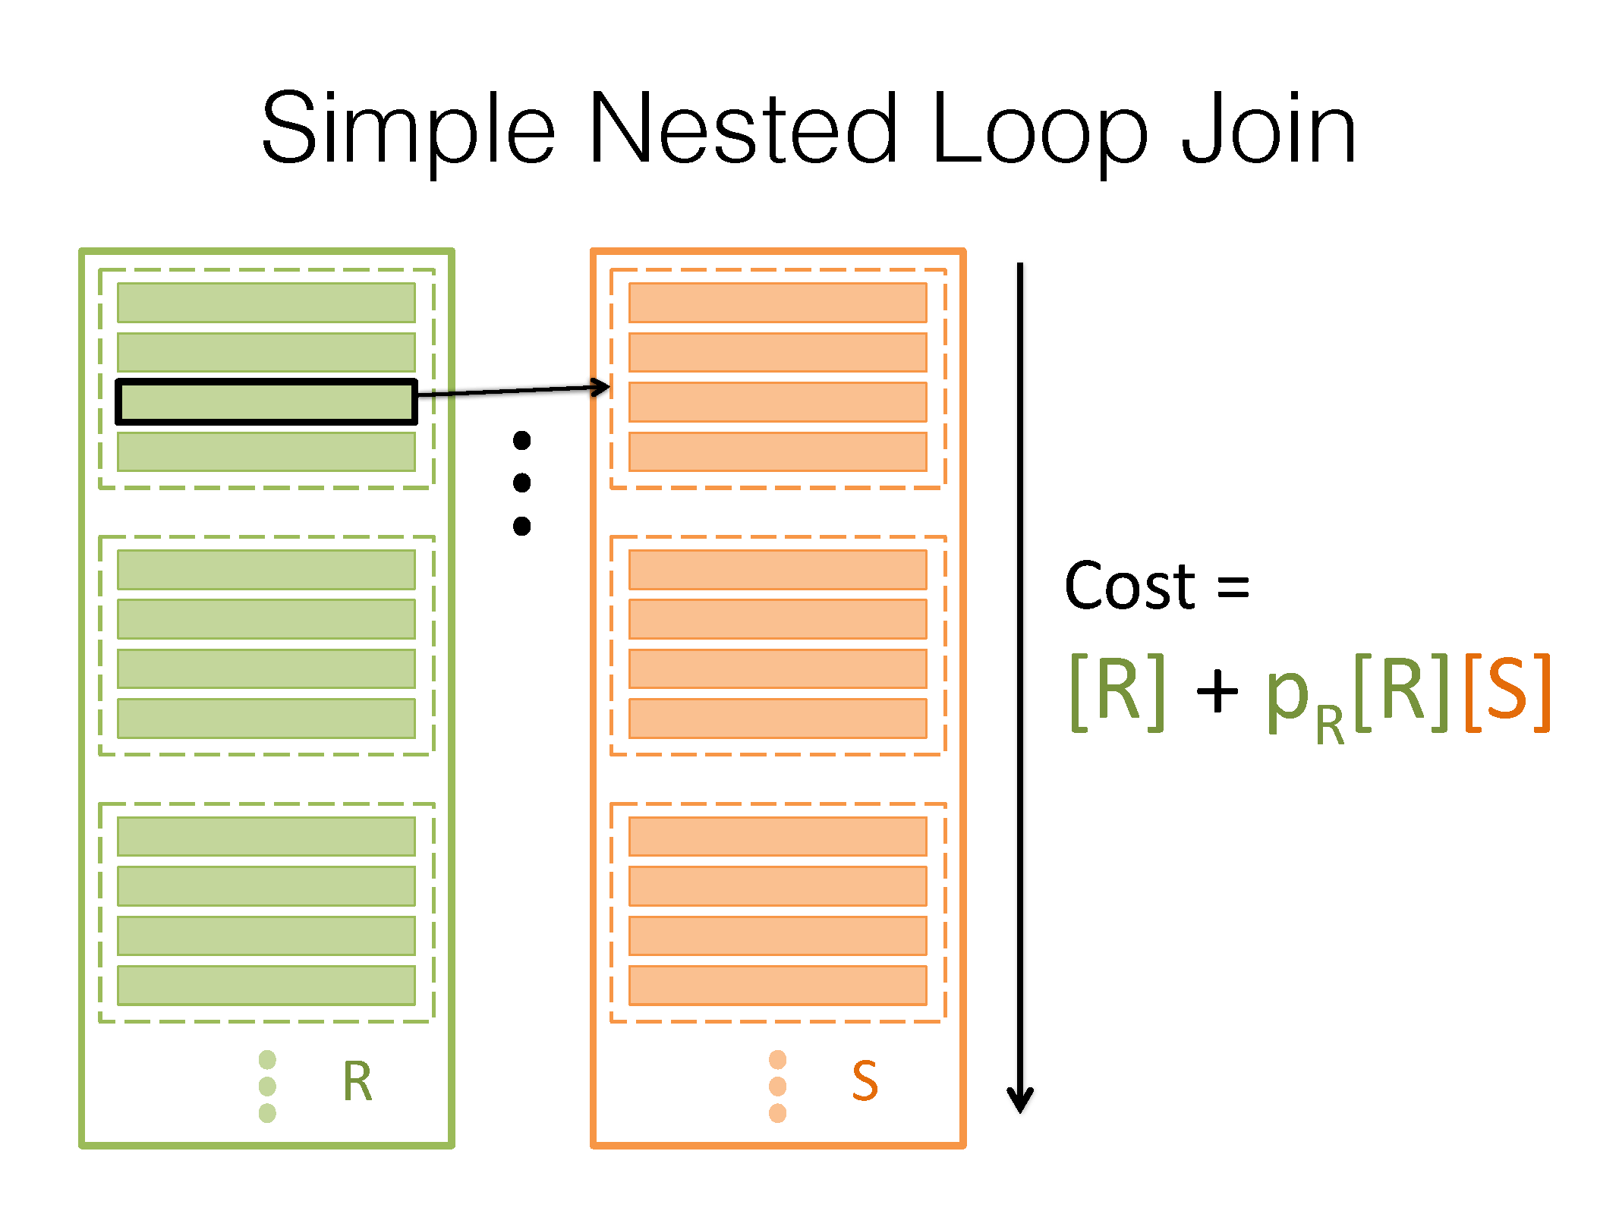
Notes:
Outer [R] comes from the fact that we have to read in each page of R, since we are comparing each tuple in R. p_R*[R] is just the number of tuples in R, and we have to compare each of those against all the pages in S.

Slide 9
Which relation should we pick as R and S respectively?
Notes:
Flipping the order can change the I/O cost, this should be taken into consideration.

Slide 10
Worksheet Q1a
How many disk I/Os are needed to perform a simple nested loops join?
Companies: (company_id, industry, ipo_date)
Nyse: (company_id, date, trade, quantity)
20 pages of memory
Join Companies and NYSE on C.company_id = N.company_id
company_id is the primary key for Companies
For every tuple in Companies, assume there are 4 matching tuples in NYSE
[N] = 100 pages, p_{N} = 100 tuples per page
[C] = 50 pages, p_{C} = 50 tuples per page

Slide 11
Worksheet Q1a
How many disk I/Os are needed to perform a simple nested loops join?
Companies: (company_id, industry, ipo_date)
Nyse: (company_id, date, trade, quantity)
20 pages of memory
We want to join Companies and NYSE on C.company_id = N.company_id
company_id is the primary key for Companies
For every tuple in Companies, assume there are 4 matching tuples in NYSE
[N] = 100 pages, p_{N} = 100 tuples per page
[C] = 50 pages, p_{C} = 50 tuples per page
C ⋈ N
Cost is [C] + |C| * [N] = [C] + p_{C} [C] [N]
= 50 + 50 * 50 * 100 = 250,050 I/Os
N ⋈ C
Cost is [N] + |N| * [C] = [N] + p_{N} [N] [C]
= 100 + 100 * 100 * 50 = 500,100 I/Os
I/O cost for SNLJ: min(500,100, 250,050) = 250,050 I/Os

Slide 12
Page Nested Loop Join (PNLJ)
Can we do better?
We scan S for every row in R, but we had to load an entire page of R into memory to get that row!
Instead of finding the rows in S that match a row in R, do the check for all rows in a page in R at once

Slide 13
Page Nested Loop Join (PNLJ)
SNLJ
for each row r in R:
for each row s in S:
if 𝜃(r, s): output r joined with s

Slide 14
Page Nested Loop Join (PNLJ)
SNLJ (but with page fetches written out explicitly)
for each page P_{R} in R:
for each row r in P_{R}:
for each page P_{S} in S:
for each row s in P_{S}:
if 𝜃(r, s): output r joined with s

Slide 15
Page Nested Loop Join (PNLJ)
PNLJ
for each page P_{R} in R:
for each page P_{S} in S:
for each row r in P_{R}:
for each row s in P_{S}:
if 𝜃(r, s): output r joined with s

Slide 16
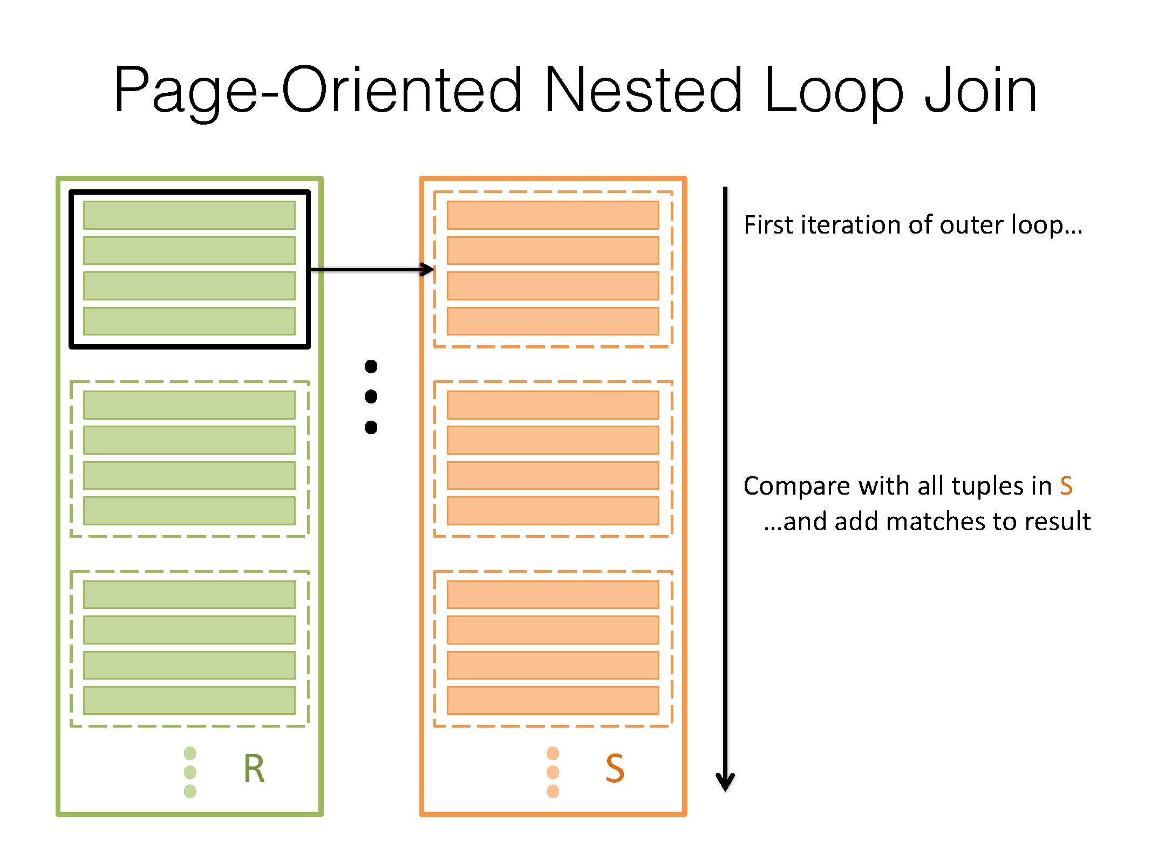

Slide 17
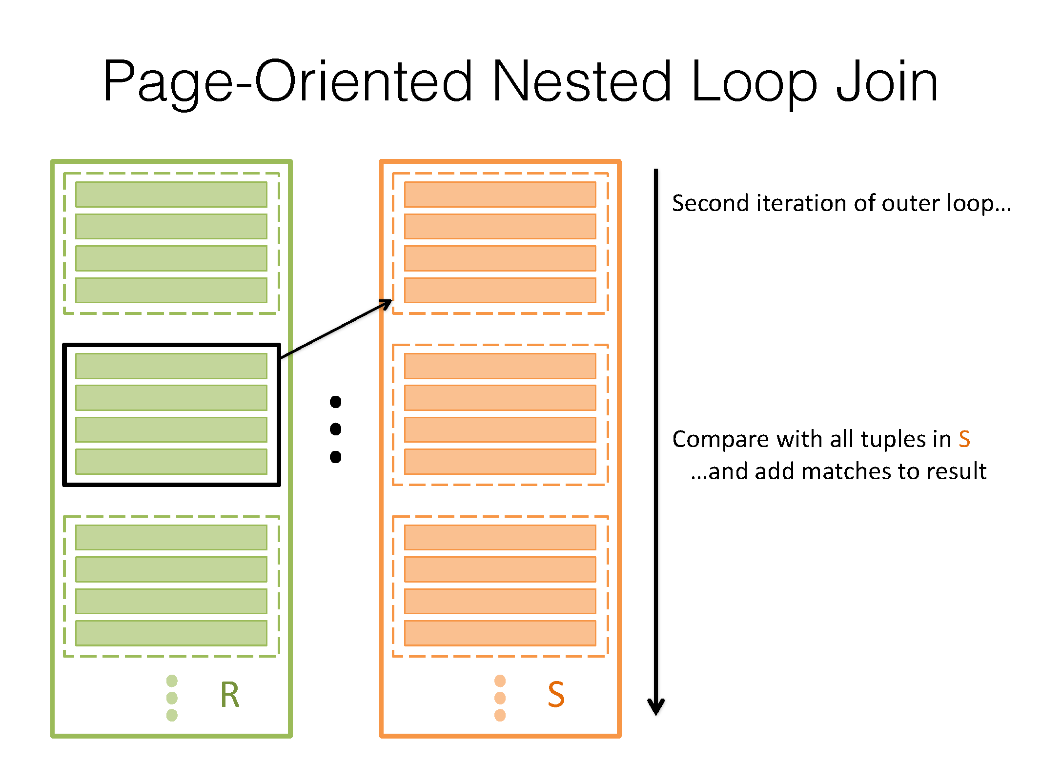

Slide 18
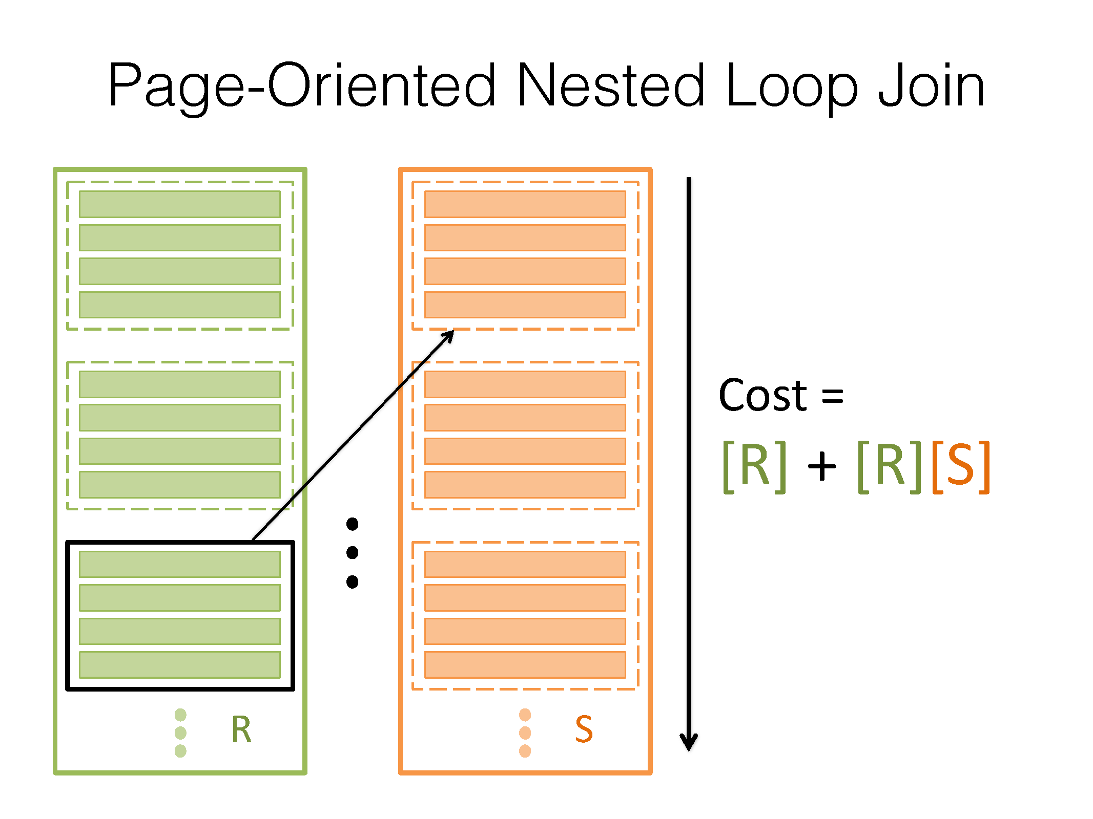
Notes:
Instead of comparing each tuple against the pages in S individually, we pull in one page at a time.

Slide 19
Block Nested Loop Join (BNLJ)
Can we do even better?
We only use three page of memory for PNLJ (one buffer for R, one buffer for S, one output buffer), but we usually have more memory!
Instead of fetching one page of R at a time, why not fetch as many pages of R as we can fit (B - 2 pages)!

Slide 20
Block Nested Loop Join (BNLJ)
PNLJ
for each page P_{R} in R:
for each page P_{S} in S:
for each row r in P_{R}:
for each row s in P_{S}:
if 𝜃(r, s): output r joined with s

Slide 21
Block Nested Loop Join (BNLJ)
BNLJ
for each block of B - 2 pages C_{R} = {P₁, P₂, ... , P_{B - 2}} in R:
for each page P_{S} in S:
for each row r in C_{R}:
for each row s in P_{S}:
if 𝜃(r, s): output r joined with s

Slide 22
R
S
B = 4
Output Buffer

Slide 23
R
S
B = 4
Output Buffer

Slide 24
R
S
B = 4
Output Buffer

Slide 25
R
S
B = 4
Output Buffer

Slide 26
R
S
B = 4
Output Buffer

Slide 27
R
S
B = 4
Output Buffer

Slide 28
R
S
B = 4
Output Buffer

Slide 29
R
S
B = 4
Output Buffer

Slide 30
BNLJ

Slide 31
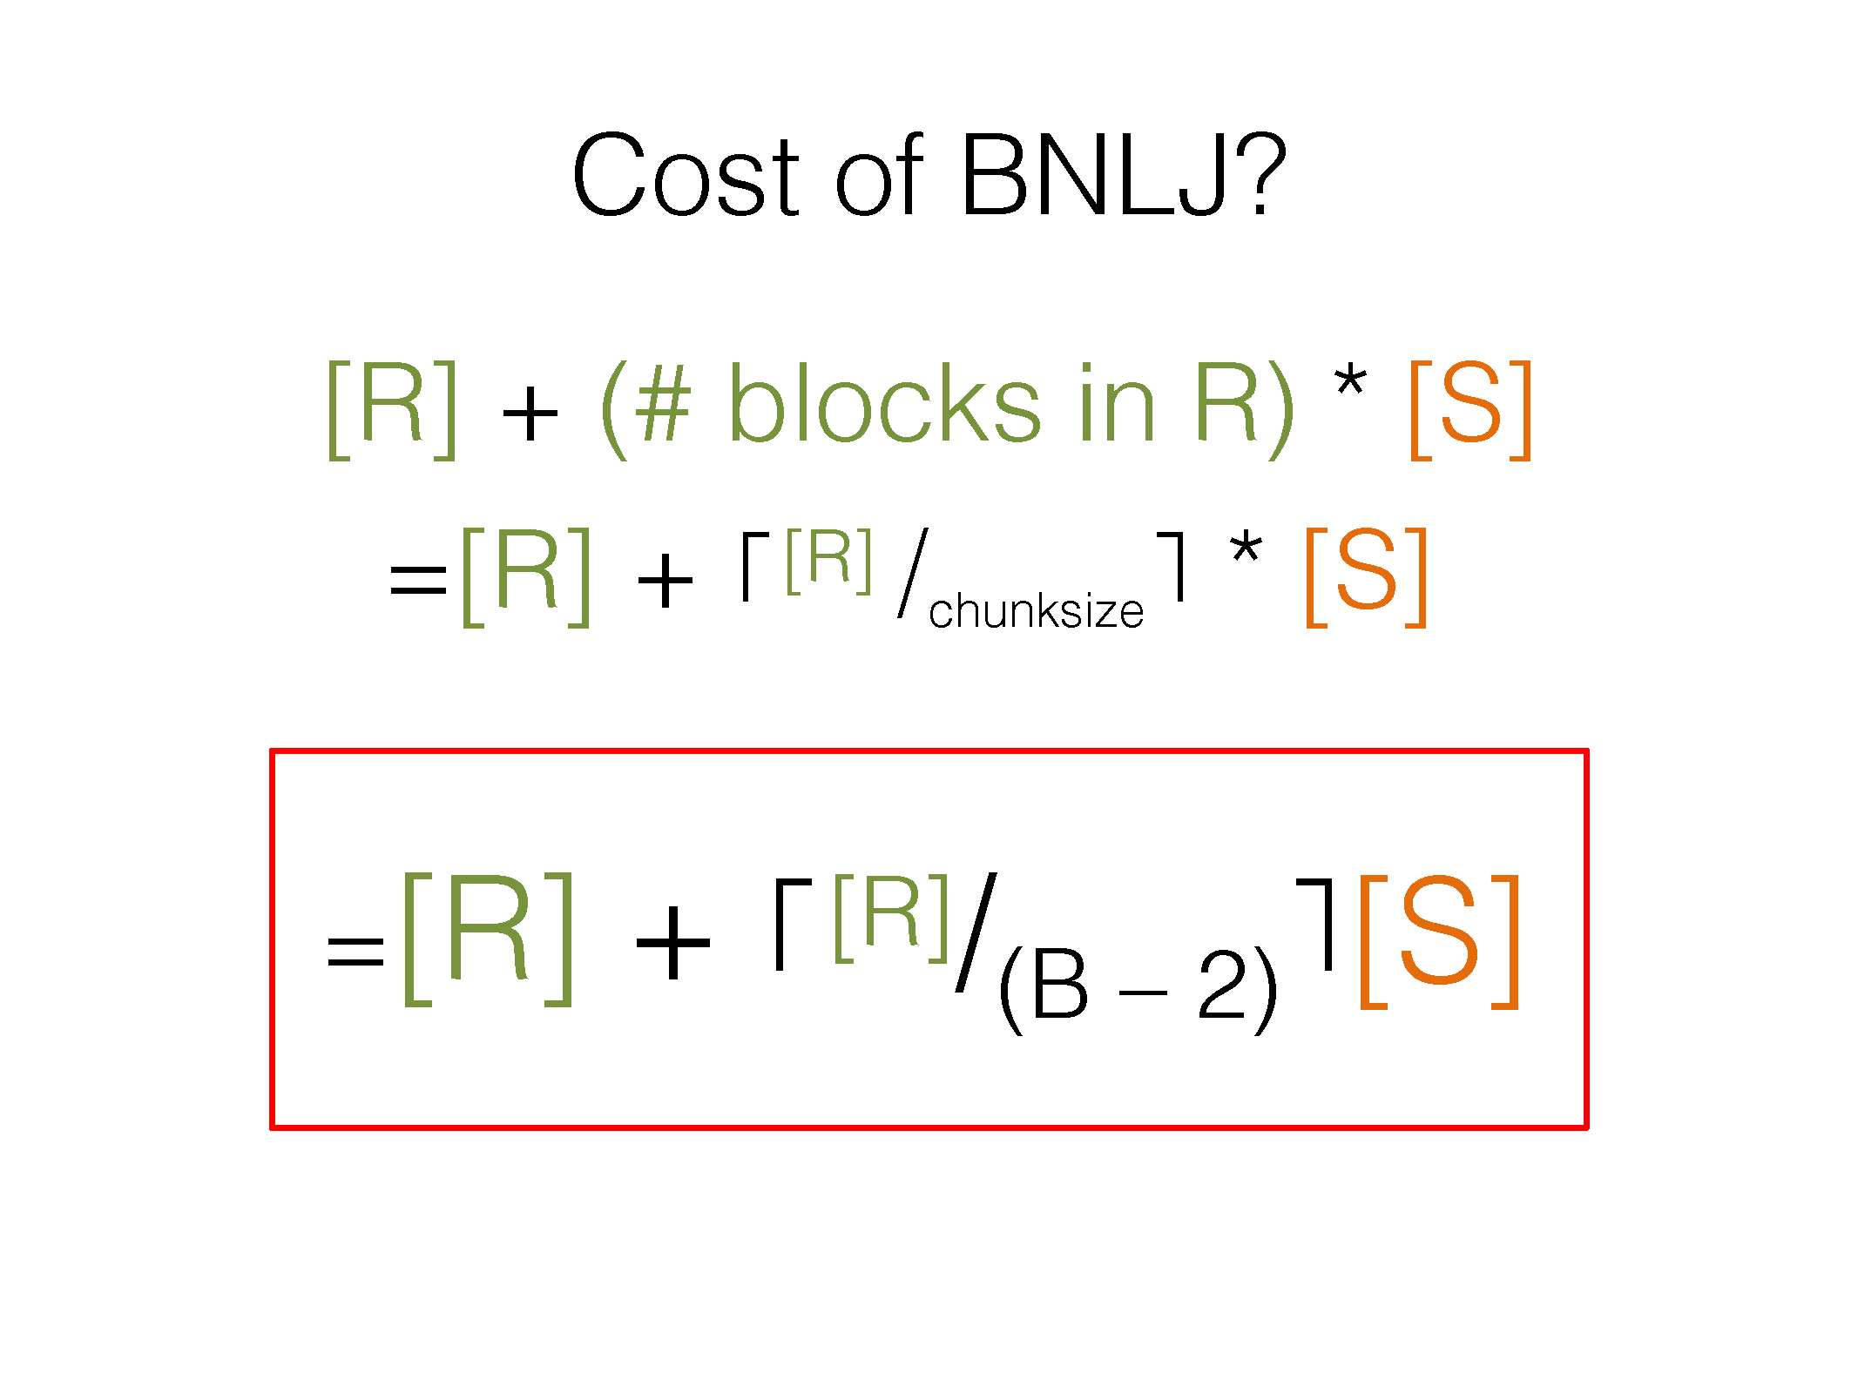
Notes:
Why B-2? We use 1 page as an output buffer and 1 page to scan S to memory one page at a time.
- When the join condition does not filter many rows (Cartesian products)
- When one table fits in a small number of blocks in memory
- Works for non-equality predicates
- Scales nicely with buffer size

Slide 32
Worksheet Q1b
How many disk I/Os are needed to perform a block nested loops join?
Companies: (company_id, industry, ipo_date)
Nyse: (company_id, date, trade, quantity)
20 pages of memory
We want to join Companies and NYSE on C.company_id = N.company_id
company_id is the primary key for Companies
For every tuple in Companies, assume there are 4 matching tuples in NYSE
[N] = 100 pages, p_{N} = 100 tuples per page
[C] = 50 pages, p_{C} = 50 tuples per page

Slide 33
Worksheet Q1b
How many disk I/Os are needed to perform a block nested loops join?
Companies: (company_id, industry, ipo_date)
Nyse: (company_id, date, trade, quantity)
20 pages of memory
We want to join Companies and NYSE on C.company_id = N.company_id
company_id is the primary key for Companies
For every tuple in Companies, assume there are 4 matching tuples in NYSE
[N] = 100 pages, p_{N} = 100 tuples per page
[C] = 50 pages, p_{C} = 50 tuples per page
Unclustered B+ indexes with height 1 on C.company_id and N.company_id
B = 20, block size = B - 2 = 18
C ⋈ N
Cost is [C] + ⌈[C] / B - 2⌉ * [N]
= 50 + ⌈50 / 18⌉ * 100 = 350 I/Os
N ⋈ C
Cost is [N] + ⌈[N] / B - 2⌉ * [C]
= 100 + ⌈100 / 18⌉ * 50 = 400 I/Os
I/O cost for BNLJ: min(350, 400) I/Os = 350 I/Os

Slide 34
Index Nested Loop Join (INLJ)
A join is essentially:
for each row r in R:
for each row s in S that satisfies 𝜃(r, s):
output r joined with s

Slide 35
Index Nested Loop Join (INLJ)
An index on S allows us to do the inner loop efficiently!
for each row r in R:
for each row s in S that satisfies 𝜃(r, s)
(found using the index):
output r joined with s

Slide 36
Index Nested Loop Join (INLJ)
What’s the I/O cost?
[R] + |R| * cost to find matching S tuples
[R] from scanning through R
Cost to find matching S tuples:
Alternative 1: cost to traverse root to leaf + read all the leaves with matching tuples
Alternative 2/3: cost of retrieving RIDs (similar to Alternative 1) + cost to fetch actual records
1 I/O per page if clustered, 1 I/O per tuple if not

Slide 37
Index Nested Loop Join (INLJ)
What’s the I/O cost?
[R] + |R| * cost to find matching S tuples
[R] from scanning through R
If we have no index, then the only way to search for matching S tuples is by scanning all of S → SNLJ
Cost to find matching S tuples is then [S], giving us the formula for SNLJ cost

Slide 38
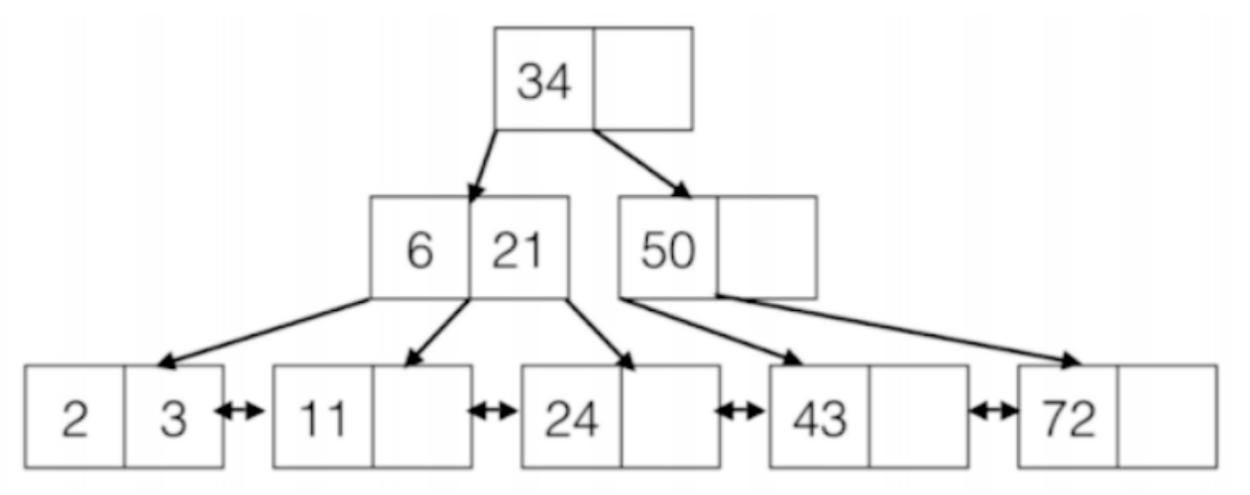
Index Nested Loop Join (INLJ)
R.col
Index on S.col
43
5
11
Output

Slide 39
Index Nested Loop Join (INLJ)
R.col
Index on S.col
43
5
11
Output

Slide 40
Index Nested Loop Join (INLJ)
R.col
Index on S.col
43
5
11
not a match
Output

Slide 41
Index Nested Loop Join (INLJ)
R.col
Index on S.col
43
5
11
Output

Slide 42
Index Nested Loop Join (INLJ)
R.col
Index on S.col
43
5
11
Output

Slide 43
Worksheet Q1c
How many disk I/Os are needed to perform an index nested loops join?
Companies: (company_id, industry, ipo_date)
Nyse: (company_id, date, trade, quantity)
20 pages of memory
We want to join Companies and NYSE on C.company_id = N.company_id
company_id is the primary key for Companies
For every tuple in Companies, assume there are 4 matching tuples in NYSE
[N] = 100 pages, p_{N} = 100 tuples per page
[C] = 50 pages, p_{C} = 50 tuples per page
Unclustered B+ indexes with height 1 on C.company_id and N.company_id

Slide 44
Worksheet Q1c
How many disk I/Os are needed to perform an index nested loops join?
Companies: (company_id, industry, ipo_date)
Nyse: (company_id, date, trade, quantity)
20 pages of memory
We want to join Companies and NYSE on C.company_id = N.company_id
company_id is the primary key for Companies
For every tuple in Companies, assume there are 4 matching tuples in NYSE
[N] = 100 pages, p_{N} = 100 tuples per page
[C] = 50 pages, p_{C} = 50 tuples per page
Unclustered B+ indexes with height 1 on C.company_id and N.company_id
C ⋈ N
Cost is [C] + |C| * cost of searching N
= 50 + (50 * 50) * (2 + 4) = 15,050 I/Os
N ⋈ C
Cost is [N] + |N| * cost of searching C
= 100 + (100 * 100) * (2 + 1) = 30,100 I/Os
I/O cost: min(30,100, 15,050) = 15,050 I/Os

Slide 45
Worksheet Q1d
Now assume the index on NYSE.company_id is clustered. What is the cost of an index nested loops join using companies as the outer relation?
Companies: (company_id, industry, ipo_date)
Nyse: (company_id, date, trade, quantity)
20 pages of memory
We want to join Companies and NYSE on C.company_id = N.company_id
company_id is the primary key for Companies
For every tuple in Companies, assume there are 4 matching tuples in NYSE
[N] = 100 pages, p_{N} = 100 tuples per page
[C] = 50 pages, p_{C} = 50 tuples per page
Unclustered B+ indexes with height 1 on C.company_id and N.company_id

Slide 46
Worksheet Q1d
Now assume the index on NYSE.company_id is clustered. What is the cost of an index nested loops join using companies as the outer relation?
Companies: (company_id, industry, ipo_date)
Nyse: (company_id, date, trade, quantity)
20 pages of memory
We want to join Companies and NYSE on C.company_id = N.company_id
company_id is the primary key for Companies
For every tuple in Companies, assume there are 4 matching tuples in NYSE
[N] = 100 pages, p_{N} = 100 tuples per page
[C] = 50 pages, p_{C} = 50 tuples per page
Unclustered B+ indexes with height 1 on C.company_id and N.company_id
C ⋈ N
Cost is [C] + |C| * cost of searching N
= 50 + 50 * 50 * (2 + # pages of matching tuples)
= 50 + 50 * 50 * (2 + ceil(# matches /p_{N} ) )
= 50 + 50 * 50 * (2 + ceil(4/100)) = 7550 I/Os

Slide 47
Sort-Merge Join (SMJ)
What if we process the data a bit before we join things together?
For example, sort both relations first! Then we can join them efficiently
In some cases, we might even have one of the relations already sorted on the right key, and then we don’t even have to spend time sorting it!

Slide 48
Sort-Merge Join (SMJ)
First step: sort both R and S (with external sorting)
Second step: merge matching tuples from R and S together
We do this efficiently by moving iterators over sorted R and sorted S in lockstep: move the iterator with the smaller key
We know that this key is smaller than all remaining key values in the other relation, so we’re completely done joining that tuple!

Slide 49
Sort-Merge Join (SMJ)
First step: sort both R and S (with external sorting)
Second step: merge matching tuples from R and S together
Need a bit more care than this: we might have multiple rows in R matching with multiple rows in S
Mark the first matching row in S, match tuples with the first matching row in R, then reset the iterator to the mark so we can go through the rows in S again for the second matching row in R

Slide 50
Sort-Merge Join
while not done {
while (r < s) { advance r }
while (r > s) { advance s }
mark s // save start of “block”
while (r == s) {
// Outer loop over r
while (r == s) {
// Inner loop over s
yield <r, s>
advance s
}
reset s to mark
advance r
}
}
sid | sname
22 | dustin
28 | yuppy
31 | lubber
31 | lubber2
44 | guppy
57 | rusty
sid | bid
28 | 103
28 | 104
31 | 101
31 | 102
42 | 142
58 | 107

Slide 51
Sort-Merge Join
while not done {
while (r < s) { advance r }
while (r > s) { advance s }
mark s // save start of “block”
while (r == s) {
// Outer loop over r
while (r == s) {
// Inner loop over s
yield <r, s>
advance s
}
reset s to mark
advance r
}
}
sid | sname
22 | dustin
28 | yuppy
31 | lubber
31 | lubber2
44 | guppy
57 | rusty
sid | bid
28 | 103
28 | 104
31 | 101
31 | 102
42 | 142
58 | 107

Slide 52
Sort-Merge Join
while not done {
while (r < s) { advance r }
while (r > s) { advance s }
mark s // save start of “block”
while (r == s) {
// Outer loop over r
while (r == s) {
// Inner loop over s
yield <r, s>
advance s
}
reset s to mark
advance r
}
}
sid | sname
22 | dustin
28 | yuppy
31 | lubber
31 | lubber2
44 | guppy
57 | rusty
sid | bid
28 | 103
28 | 104
31 | 101
31 | 102
42 | 142
58 | 107

Slide 53
Sort-Merge Join
while not done {
while (r < s) { advance r }
while (r > s) { advance s }
mark s // save start of “block”
while (r == s) {
// Outer loop over r
while (r == s) {
// Inner loop over s
yield <r, s>
advance s
}
reset s to mark
advance r
}
}
sid | sname
22 | dustin
28 | yuppy
31 | lubber
31 | lubber2
44 | guppy
57 | rusty
sid | bid
28 | 103
28 | 104
31 | 101
31 | 102
42 | 142
58 | 107
sid | sname | bid
28 | yuppy | 103

Slide 54
Sort-Merge Join
while not done {
while (r < s) { advance r }
while (r > s) { advance s }
mark s // save start of “block”
while (r == s) {
// Outer loop over r
while (r == s) {
// Inner loop over s
yield <r, s>
advance s
}
reset s to mark
advance r
}
}
sid | sname
22 | dustin
28 | yuppy
31 | lubber
31 | lubber2
44 | guppy
57 | rusty
sid | bid
28 | 103
28 | 104
31 | 101
31 | 102
42 | 142
58 | 107
sid | sname | bid
28 | yuppy | 103

Slide 55
Sort-Merge Join
while not done {
while (r < s) { advance r }
while (r > s) { advance s }
mark s // save start of “block”
while (r == s) {
// Outer loop over r
while (r == s) {
// Inner loop over s
yield <r, s>
advance s
}
reset s to mark
advance r
}
}
sid | sname
22 | dustin
28 | yuppy
31 | lubber
31 | lubber2
44 | guppy
57 | rusty
sid | bid
28 | 103
28 | 104
31 | 101
31 | 102
42 | 142
58 | 107
sid | sname | bid
28 | yuppy | 103
28 | yuppy | 104

Slide 56
Sort-Merge Join
while not done {
while (r < s) { advance r }
while (r > s) { advance s }
mark s // save start of “block”
while (r == s) {
// Outer loop over r
while (r == s) {
// Inner loop over s
yield <r, s>
advance s
}
reset s to mark
advance r
}
}
sid | sname
22 | dustin
28 | yuppy
31 | lubber
31 | lubber2
44 | guppy
57 | rusty
sid | bid
28 | 103
28 | 104
31 | 101
31 | 102
42 | 142
58 | 107
sid | sname | bid
28 | yuppy | 103
28 | yuppy | 104

Slide 57
Sort-Merge Join
while not done {
while (r < s) { advance r }
while (r > s) { advance s }
mark s // save start of “block”
while (r == s) {
// Outer loop over r
while (r == s) {
// Inner loop over s
yield <r, s>
advance s
}
reset s to mark
advance r
}
}
sid | sname
22 | dustin
28 | yuppy
31 | lubber
31 | lubber2
44 | guppy
57 | rusty
sid | bid
28 | 103
28 | 104
31 | 101
31 | 102
42 | 142
58 | 107
sid | sname | bid
28 | yuppy | 103
28 | yuppy | 104

Slide 58
Sort-Merge Join
while not done {
while (r < s) { advance r }
while (r > s) { advance s }
mark s // save start of “block”
while (r == s) {
// Outer loop over r
while (r == s) {
// Inner loop over s
yield <r, s>
advance s
}
reset s to mark
advance r
}
}
sid | sname
22 | dustin
28 | yuppy
31 | lubber
31 | lubber2
44 | guppy
57 | rusty
sid | bid
28 | 103
28 | 104
31 | 101
31 | 102
42 | 142
58 | 107
sid | sname | bid
28 | yuppy | 103
28 | yuppy | 104

Slide 59
Sort-Merge Join
while not done {
while (r < s) { advance r }
while (r > s) { advance s }
mark s // save start of “block”
while (r == s) {
// Outer loop over r
while (r == s) {
// Inner loop over s
yield <r, s>
advance s
}
reset s to mark
advance r
}
}
sid | sname
22 | dustin
28 | yuppy
31 | lubber
31 | lubber2
44 | guppy
57 | rusty
sid | bid
28 | 103
28 | 104
31 | 101
31 | 102
42 | 142
58 | 107
sid | sname | bid
28 | yuppy | 103
28 | yuppy | 104

Slide 60
Sort-Merge Join
while not done {
while (r < s) { advance r }
while (r > s) { advance s }
mark s // save start of “block”
while (r == s) {
// Outer loop over r
while (r == s) {
// Inner loop over s
yield <r, s>
advance s
}
reset s to mark
advance r
}
}
sid | sname
22 | dustin
28 | yuppy
31 | lubber
31 | lubber2
44 | guppy
57 | rusty
sid | bid
28 | 103
28 | 104
31 | 101
31 | 102
42 | 142
58 | 107
sid | sname | bid
28 | yuppy | 103
28 | yuppy | 104

Slide 61
Sort-Merge Join
while not done {
while (r < s) { advance r }
while (r > s) { advance s }
mark s // save start of “block”
while (r == s) {
// Outer loop over r
while (r == s) {
// Inner loop over s
yield <r, s>
advance s
}
reset s to mark
advance r
}
}
sid | sname
22 | dustin
28 | yuppy
31 | lubber
31 | lubber2
44 | guppy
57 | rusty
sid | bid
28 | 103
28 | 104
31 | 101
31 | 102
42 | 142
58 | 107
sid | sname | bid
28 | yuppy | 103
28 | yuppy | 104

Slide 62
Sort-Merge Join
while not done {
while (r < s) { advance r }
while (r > s) { advance s }
mark s // save start of “block”
while (r == s) {
// Outer loop over r
while (r == s) {
// Inner loop over s
yield <r, s>
advance s
}
reset s to mark
advance r
}
}
sid | sname
22 | dustin
28 | yuppy
31 | lubber
31 | lubber2
44 | guppy
57 | rusty
sid | bid
28 | 103
28 | 104
31 | 101
31 | 102
42 | 142
58 | 107
sid | sname | bid
28 | yuppy | 103
28 | yuppy | 104

Slide 63
Sort-Merge Join
while not done {
while (r < s) { advance r }
while (r > s) { advance s }
mark s // save start of “block”
while (r == s) {
// Outer loop over r
while (r == s) {
// Inner loop over s
yield <r, s>
advance s
}
reset s to mark
advance r
}
}
sid | sname
22 | dustin
28 | yuppy
31 | lubber
31 | lubber2
44 | guppy
57 | rusty
sid | bid
28 | 103
28 | 104
31 | 101
31 | 102
42 | 142
58 | 107
sid | sname | bid
28 | yuppy | 103
28 | yuppy | 104
31 | lubber | 101

Slide 64
Sort-Merge Join
while not done {
while (r < s) { advance r }
while (r > s) { advance s }
mark s // save start of “block”
while (r == s) {
// Outer loop over r
while (r == s) {
// Inner loop over s
yield <r, s>
advance s
}
reset s to mark
advance r
}
}
sid | sname
22 | dustin
28 | yuppy
31 | lubber
31 | lubber2
44 | guppy
57 | rusty
sid | bid
28 | 103
28 | 104
31 | 101
31 | 102
42 | 142
58 | 107
sid | sname | bid
28 | yuppy | 103
28 | yuppy | 104
31 | lubber | 101

Slide 65
Sort-Merge Join
while not done {
while (r < s) { advance r }
while (r > s) { advance s }
mark s // save start of “block”
while (r == s) {
// Outer loop over r
while (r == s) {
// Inner loop over s
yield <r, s>
advance s
}
reset s to mark
advance r
}
}
sid | sname
22 | dustin
28 | yuppy
31 | lubber
31 | lubber2
44 | guppy
57 | rusty
sid | bid
28 | 103
28 | 104
31 | 101
31 | 102
42 | 142
58 | 107
sid | sname | bid
28 | yuppy | 103
28 | yuppy | 104
31 | lubber | 101
31 | lubber | 102

Slide 66
Sort-Merge Join
while not done {
while (r < s) { advance r }
while (r > s) { advance s }
mark s // save start of “block”
while (r == s) {
// Outer loop over r
while (r == s) {
// Inner loop over s
yield <r, s>
advance s
}
reset s to mark
advance r
}
}
sid | sname
22 | dustin
28 | yuppy
31 | lubber
31 | lubber2
44 | guppy
57 | rusty
sid | bid
28 | 103
28 | 104
31 | 101
31 | 102
42 | 142
58 | 107
sid | sname | bid
28 | yuppy | 103
28 | yuppy | 104
31 | lubber | 101
31 | lubber | 102

Slide 67
Sort-Merge Join
while not done {
while (r < s) { advance r }
while (r > s) { advance s }
mark s // save start of “block”
while (r == s) {
// Outer loop over r
while (r == s) {
// Inner loop over s
yield <r, s>
advance s
}
reset s to mark
advance r
}
}
sid | sname
22 | dustin
28 | yuppy
31 | lubber
31 | lubber2
44 | guppy
57 | rusty
sid | bid
28 | 103
28 | 104
31 | 101
31 | 102
42 | 142
58 | 107
sid | sname | bid
28 | yuppy | 103
28 | yuppy | 104
31 | lubber | 101
31 | lubber | 102

Slide 68
Sort-Merge Join
while not done {
while (r < s) { advance r }
while (r > s) { advance s }
mark s // save start of “block”
while (r == s) {
// Outer loop over r
while (r == s) {
// Inner loop over s
yield <r, s>
advance s
}
reset s to mark
advance r
}
}
sid | sname
22 | dustin
28 | yuppy
31 | lubber
31 | lubber2
44 | guppy
57 | rusty
sid | bid
28 | 103
28 | 104
31 | 101
31 | 102
42 | 142
58 | 107
sid | sname | bid
28 | yuppy | 103
28 | yuppy | 104
31 | lubber | 101
31 | lubber | 102

Slide 69
Sort-Merge Join
while not done {
while (r < s) { advance r }
while (r > s) { advance s }
mark s // save start of “block”
while (r == s) {
// Outer loop over r
while (r == s) {
// Inner loop over s
yield <r, s>
advance s
}
reset s to mark
advance r
}
}
sid | sname
22 | dustin
28 | yuppy
31 | lubber
31 | lubber2
44 | guppy
57 | rusty
sid | bid
28 | 103
28 | 104
31 | 101
31 | 102
42 | 142
58 | 107
sid | sname | bid
28 | yuppy | 103
28 | yuppy | 104
31 | lubber | 101
31 | lubber | 102
31 | lubber2 | 101

Slide 70
Sort-Merge Join
while not done {
while (r < s) { advance r }
while (r > s) { advance s }
mark s // save start of “block”
while (r == s) {
// Outer loop over r
while (r == s) {
// Inner loop over s
yield <r, s>
advance s
}
reset s to mark
advance r
}
}
sid | sname
22 | dustin
28 | yuppy
31 | lubber
31 | lubber2
44 | guppy
57 | rusty
sid | bid
28 | 103
28 | 104
31 | 101
31 | 102
42 | 142
58 | 107
sid | sname | bid
28 | yuppy | 103
28 | yuppy | 104
31 | lubber | 101
31 | lubber | 102
31 | lubber2 | 101

Slide 71
Sort-Merge Join
while not done {
while (r < s) { advance r }
while (r > s) { advance s }
mark s // save start of “block”
while (r == s) {
// Outer loop over r
while (r == s) {
// Inner loop over s
yield <r, s>
advance s
}
reset s to mark
advance r
}
}
sid | sname
22 | dustin
28 | yuppy
31 | lubber
31 | lubber2
44 | guppy
57 | rusty
sid | bid
28 | 103
28 | 104
31 | 101
31 | 102
42 | 142
58 | 107
sid | sname | bid
28 | yuppy | 103
28 | yuppy | 104
31 | lubber | 101
31 | lubber | 102
31 | lubber2 | 101
31 | lubber2 | 102

Slide 72
Sort-Merge Join
while not done {
while (r < s) { advance r }
while (r > s) { advance s }
mark s // save start of “block”
while (r == s) {
// Outer loop over r
while (r == s) {
// Inner loop over s
yield <r, s>
advance s
}
reset s to mark
advance r
}
}
sid | sname
22 | dustin
28 | yuppy
31 | lubber
31 | lubber2
44 | guppy
57 | rusty
sid | bid
28 | 103
28 | 104
31 | 101
31 | 102
42 | 142
58 | 107
sid | sname | bid
28 | yuppy | 103
28 | yuppy | 104
31 | lubber | 101
31 | lubber | 102
31 | lubber2 | 101
31 | lubber2 | 102

Slide 73
Sort-Merge Join
while not done {
while (r < s) { advance r }
while (r > s) { advance s }
mark s // save start of “block”
while (r == s) {
// Outer loop over r
while (r == s) {
// Inner loop over s
yield <r, s>
advance s
}
reset s to mark
advance r
}
}
sid | sname
22 | dustin
28 | yuppy
31 | lubber
31 | lubber2
44 | guppy
57 | rusty
sid | bid
28 | 103
28 | 104
31 | 101
31 | 102
42 | 142
58 | 107
sid | sname | bid
28 | yuppy | 103
28 | yuppy | 104
31 | lubber | 101
31 | lubber | 102
31 | lubber2 | 101
31 | lubber2 | 102

Slide 74
Sort-Merge Join
while not done {
while (r < s) { advance r }
while (r > s) { advance s }
mark s // save start of “block”
while (r == s) {
// Outer loop over r
while (r == s) {
// Inner loop over s
yield <r, s>
advance s
}
reset s to mark
advance r
}
}
sid | sname
22 | dustin
28 | yuppy
31 | lubber
31 | lubber2
44 | guppy
57 | rusty
sid | bid
28 | 103
28 | 104
31 | 101
31 | 102
42 | 142
58 | 107
sid | sname | bid
28 | yuppy | 103
28 | yuppy | 104
31 | lubber | 101
31 | lubber | 102
31 | lubber2 | 101
31 | lubber2 | 102

Slide 75
Sort-Merge Join
while not done {
while (r < s) { advance r }
while (r > s) { advance s }
mark s // save start of “block”
while (r == s) {
// Outer loop over r
while (r == s) {
// Inner loop over s
yield <r, s>
advance s
}
reset s to mark
advance r
}
}
sid | sname
22 | dustin
28 | yuppy
31 | lubber
31 | lubber2
44 | guppy
57 | rusty
sid | bid
28 | 103
28 | 104
31 | 101
31 | 102
42 | 142
58 | 107
sid | sname | bid
28 | yuppy | 103
28 | yuppy | 104
31 | lubber | 101
31 | lubber | 102
31 | lubber2 | 101
31 | lubber2 | 102

Slide 76
Sort-Merge Join
while not done {
while (r < s) { advance r }
while (r > s) { advance s }
mark s // save start of “block”
while (r == s) {
// Outer loop over r
while (r == s) {
// Inner loop over s
yield <r, s>
advance s
}
reset s to mark
advance r
}
}
sid | sname
22 | dustin
28 | yuppy
31 | lubber
31 | lubber2
44 | guppy
57 | rusty
sid | bid
28 | 103
28 | 104
31 | 101
31 | 102
42 | 142
58 | 107
sid | sname | bid
28 | yuppy | 103
28 | yuppy | 104
31 | lubber | 101
31 | lubber | 102
31 | lubber2 | 101
31 | lubber2 | 102

Slide 77
Sort-Merge Join
while not done {
while (r < s) { advance r }
while (r > s) { advance s }
mark s // save start of “block”
while (r == s) {
// Outer loop over r
while (r == s) {
// Inner loop over s
yield <r, s>
advance s
}
reset s to mark
advance r
}
}
sid | sname
22 | dustin
28 | yuppy
31 | lubber
31 | lubber2
44 | guppy
57 | rusty
sid | bid
28 | 103
28 | 104
31 | 101
31 | 102
42 | 142
58 | 107
sid | sname | bid
28 | yuppy | 103
28 | yuppy | 104
31 | lubber | 101
31 | lubber | 102
31 | lubber2 | 101
31 | lubber2 | 102

Slide 78
Sort-Merge Join
while not done {
while (r < s) { advance r }
while (r > s) { advance s }
mark s // save start of “block”
while (r == s) {
// Outer loop over r
while (r == s) {
// Inner loop over s
yield <r, s>
advance s
}
reset s to mark
advance r
}
}
sid | sname
22 | dustin
28 | yuppy
31 | lubber
31 | lubber2
44 | guppy
57 | rusty
sid | bid
28 | 103
28 | 104
31 | 101
31 | 102
42 | 142
58 | 107
sid | sname | bid
28 | yuppy | 103
28 | yuppy | 104
31 | lubber | 101
31 | lubber | 102
31 | lubber2 | 101
31 | lubber2 | 102

Slide 79
Sort-Merge Join
while not done {
while (r < s) { advance r }
while (r > s) { advance s }
mark s // save start of “block”
while (r == s) {
// Outer loop over r
while (r == s) {
// Inner loop over s
yield <r, s>
advance s
}
reset s to mark
advance r
}
}
sid | sname
22 | dustin
28 | yuppy
31 | lubber
31 | lubber2
44 | guppy
57 | rusty
sid | bid
28 | 103
28 | 104
31 | 101
31 | 102
42 | 142
58 | 107
sid | sname | bid
28 | yuppy | 103
28 | yuppy | 104
31 | lubber | 101
31 | lubber | 102
31 | lubber2 | 101
31 | lubber2 | 102

Slide 80
Sort-Merge Join
while not done {
while (r < s) { advance r }
while (r > s) { advance s }
mark s // save start of “block”
while (r == s) {
// Outer loop over r
while (r == s) {
// Inner loop over s
yield <r, s>
advance s
}
reset s to mark
advance r
}
}
sid | sname
22 | dustin
28 | yuppy
31 | lubber
31 | lubber2
44 | guppy
57 | rusty
sid | bid
28 | 103
28 | 104
31 | 101
31 | 102
42 | 142
58 | 107
sid | sname | bid
28 | yuppy | 103
28 | yuppy | 104
31 | lubber | 101
31 | lubber | 102
31 | lubber2 | 101
31 | lubber2 | 102

Slide 81
Sort-Merge Join
while not done {
while (r < s) { advance r }
while (r > s) { advance s }
mark s // save start of “block”
while (r == s) {
// Outer loop over r
while (r == s) {
// Inner loop over s
yield <r, s>
advance s
}
reset s to mark
advance r
}
}
sid | sname
22 | dustin
28 | yuppy
31 | lubber
31 | lubber2
44 | guppy
57 | rusty
sid | bid
28 | 103
28 | 104
31 | 101
31 | 102
42 | 142
58 | 107
sid | sname | bid
28 | yuppy | 103
28 | yuppy | 104
31 | lubber | 101
31 | lubber | 102
31 | lubber2 | 101
31 | lubber2 | 102

Slide 82
Sort-Merge Join
while not done {
while (r < s) { advance r }
while (r > s) { advance s }
mark s // save start of “block”
while (r == s) {
// Outer loop over r
while (r == s) {
// Inner loop over s
yield <r, s>
advance s
}
reset s to mark
advance r
}
}
sid | sname
22 | dustin
28 | yuppy
31 | lubber
31 | lubber2
44 | guppy
57 | rusty
sid | bid
28 | 103
28 | 104
31 | 101
31 | 102
42 | 142
58 | 107
sid | sname | bid
28 | yuppy | 103
28 | yuppy | 104
31 | lubber | 101
31 | lubber | 102
31 | lubber2 | 101
31 | lubber2 | 102

Slide 83
Sort-Merge Join (SMJ)
I/O cost?
Cost of sorting R
Cost of sorting S
The merge step: [R] + [S]
Only one pass (if we assume there aren’t a lot of duplicates)

Slide 84
Sort-Merge Join (SMJ)
An optimization we can sometimes make
We only have to (assuming no duplicate values in R) make one pass through the sorted relation → we don’t need the sorted relations to be materialized!
In the final merge pass of sorting both relations, instead of writing the sorted relations to disk, we can stream them into the second part of SMJ!
Reduces I/O cost by 2*([R] + [S])!

Slide 85
Sort-Merge Join (SMJ)
An optimization we can sometimes make
In the final merge pass of sorting both relations, instead of writing the sorted relations to disk, we can stream them into the second part of SMJ!
We have to be able to fit the input buffers of the last merge pass of sorting R and sorting S in memory, as well as have one output buffer for joined tuples
Need: # runs in last merge pass for R + # runs in last merge pass for S ≤ B - 1

Slide 86
Worksheet Q1e
Companies: (company_id, industry, ipo_date)
Nyse: (company_id, date, trade, quantity)
20 pages of memory
[N] = 100 pages, p_{N} = 100 tuples per page
[C] = 50 pages, p_{C} = 50 tuples per page
How many disk I/Os are needed to perform a sort-merge join (unoptimized/optimized)?

Slide 87
Worksheet Q1e
Companies: (company_id, industry, ipo_date)
Nyse: (company_id, date, trade, quantity)
20 pages of memory
[N] = 100 pages, p_{N} = 100 tuples per page
[C] = 50 pages, p_{C} = 50 tuples per page
How many disk I/Os are needed to perform a sort-merge join (unoptimized/optimized)?
Unoptimized:
Sorting N:
Pass 0 - ceil(100/20) = 5 sorted runs of 20 pages each
Pass 1 - ceil(5/19) = 1 sorted run of 100 pages each
Total I/Os: 4 * (100 pages) = 400 I/Os
Sorting C:
Pass 0 - ceil(50/20) = 3 sorted runs of 20 pages, 20 pages, and 10 pages
Pass 1 - ceil(3/19) = 1 sorted run of 50 pages
Total I/Os: 4 * (50 pages) = 200 I/Os
Merging: [C] + [N] = 150 I/Os
Total SMJ I/Os: 200 + 400 + 150 = 750 I/Os

Slide 88
Worksheet Q1e
Companies: (company_id, industry, ipo_date)
Nyse: (company_id, date, trade, quantity)
20 pages of memory
[N] = 100 pages, p_{N} = 100 tuples per page
[C] = 50 pages, p_{C} = 50 tuples per page
How many disk I/Os are needed to perform a sort-merge join (unoptimized/optimized)?
Can we perform the SMJ optimization?
Sorting N:
Pass 0 - ceil(100/20) = 5 sorted runs of 20 pages each
Pass 1 - ceil(5/19) = 1 sorted run of 100 pages each
Total I/Os: 4 * (100 pages) = 400 I/Os
Sorting C:
Pass 0 - ceil(50/20) = 3 sorted runs of 20 pages, 20 pages, and 10 pages
Pass 1 - ceil(3/19) = 1 sorted run of 50 pages
Total I/Os: 4 * (50 pages) = 200 I/Os

Slide 89
Worksheet Q1e
Companies: (company_id, industry, ipo_date)
Nyse: (company_id, date, trade, quantity)
20 pages of memory
[N] = 100 pages, p_{N} = 100 tuples per page
[C] = 50 pages, p_{C} = 50 tuples per page
How many disk I/Os are needed to perform a sort-merge join (unoptimized/optimized)?
Can we perform the SMJ optimization?
Yes.
During the 2nd to last pass, we produce 5 sorted runs of N and 3 sorted runs of C. Since the number of runs of C + the number of runs of N ≤ 20 - 1, we can optimize sort merge join and combine the last sorting pass and final merging pass to save 2 * ([C] + [N]) I/Os.
Total I/Os = 750 - 2(50+100) = 450 I/Os

